Slide 1

PUBLIC SAFETY & RESOURCE ALLOCATION
US Crime Profiling Clustering Analytics
Utilizing K-Means and Hierarchical Clustering to segment states by crime severity and population density for targeted policy intervention.

Slide 2

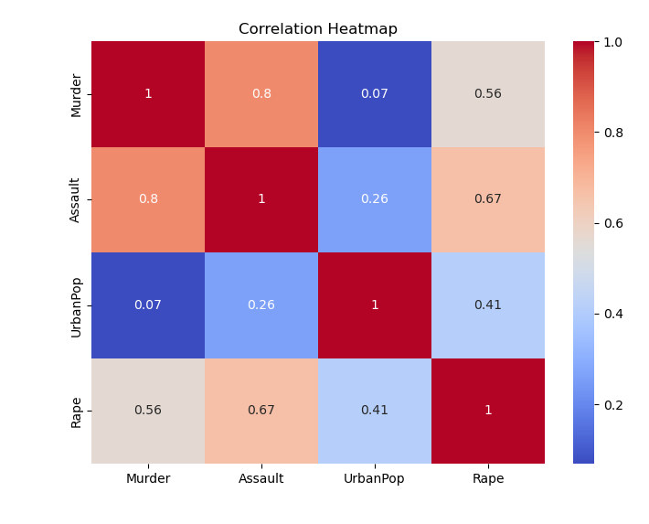

BUSINESS OBJECTIVE & DATASET
Strategic Goal
Law enforcement resources and federal grants cannot be distributed evenly. By clustering states based on their unique crime signatures and urbanization levels, policymakers can tailor specific interventions (e.g., gang-violence task forces vs. rural patrol funding) to the regions that fit those exact profiles.
Dataset: 50 records, 4 variables — Murder, Assault, UrbanPop, Rape

Slide 3

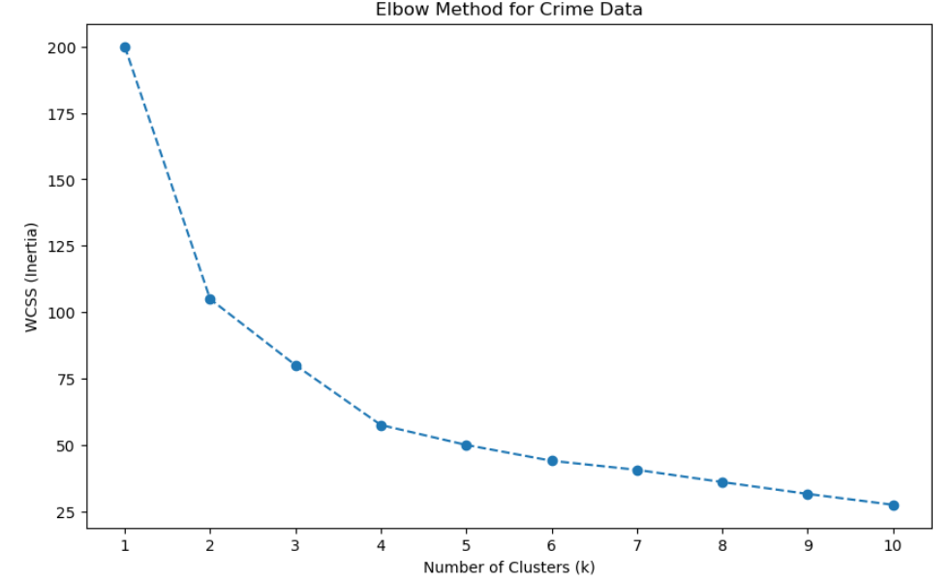
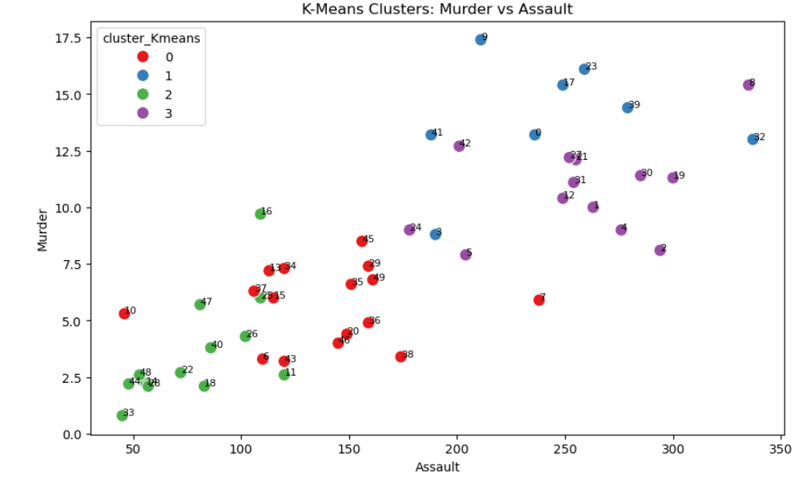
EXPLORATORY DATA ANALYSIS & TUNING
Elbow Curve
Cluster Scatter Plot

Slide 4


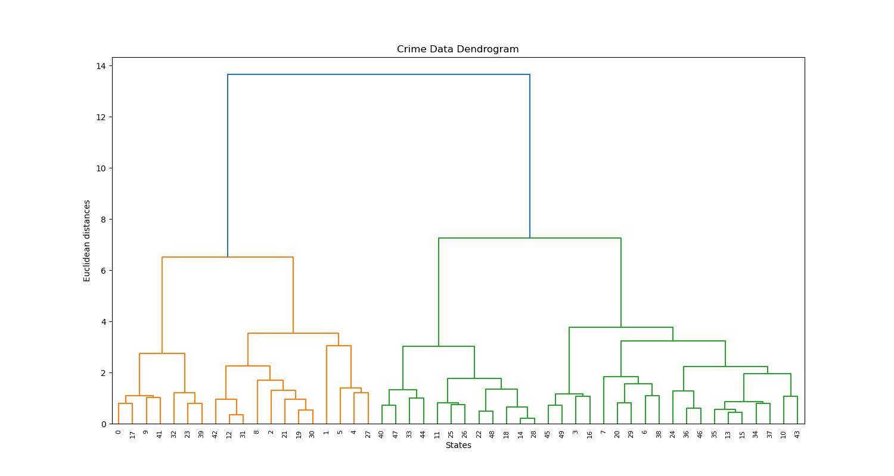

HIERARCHICAL CLUSTERING INFERENCE
Dendrogram Architecture
Hierarchical clustering naturally grouped the 50 states into 3 distinct branches based on Euclidean distance.
Key Discoveries
▪
The Murder Gap: Murder rates in Cluster 0 (12.3) are exponentially (4x) higher than in Cluster 2 (3.09).
▪
The Urban Factor: Cluster 1 is highly urbanized, yet significantly safer than Cluster 0. This mathematically proves that severe violent crime is not purely a byproduct of high population density.

Slide 5




K-MEANS: THE CORE RISK SEGMENTS
The High-Violence States
Dangerous Urban Hubs
Highest Murder rates (avg ~14) despite having a lower urban population than major metropolitan hubs.
Highest Urban Population (avg ~76%) paired with the highest overall Assault and Rape rates.
Action Plan: Require intense, high-priority violent crime intervention and community-based de-escalation programs.
Action Plan: Focus on density-driven crime. Increase public safety infrastructure, lighting, and police presence in metropolitan corridors.

Slide 6




K-MEANS: THE CORE RISK SEGMENTS
Stable Metropolitan States
Safe Rural States
Highly urbanized (avg ~74%) but successfully manage to keep Murder and Assault rates significantly lower than Cluster 3.
The "Low-Risk" group. Lowest crime rates across every single category and the lowest urbanization.
Action Plan: These are the "model" large states. Study their social programs and community policing strategies for national export.
Action Plan: Maintain rural community stability. Lower-intensity, community-focused patrol operations are sufficient.

Slide 7




CONCLUSION & NEXT STEPS
Model Summary
Key Takeaway
Next Steps
Successfully segmented 50 states into distinct risk profiles using K-Means (K=4) and Hierarchical (K=3) algorithms, replacing uniform policies with data-backed clusters.
Crime severity is not strictly bound to urbanization. "Stable Metro" states prove density doesn't equal murder, while "High-Violence" states suffer despite lower populations.
Integrate economic indicators (poverty rates, unemployment, education) into the dataset to identify the true root causes driving the "High-Violence" cluster.

